Slide 1

City of Laguna Beach
Investment Status Report April 30, 2022
With Guest Financial Expert
Bill Blackwill, Managing Director
Stifel Investment Services
Monday June 6, 2022 1:30pm
Agenda
Introductions – Thank you to public volunteers Karl Koski and welcome to Glenn Grey
Economic update – Bill Blackwill
Laguna Beach Portfolio Update
2021 Investment Strategy and Policy Discussion
Laura Parisi, CPA, CCMT Victoria H. McIntosh, CPA
City Treasurer Deputy City Treasurer
lparisi@lagunabeachcity.net
(949)497-0327 office (part-time) (949)677-0327 cell

Slide 2
Economic Update
Bill Blackwill, Managing Director
Stifel Investment Services

Slide 3
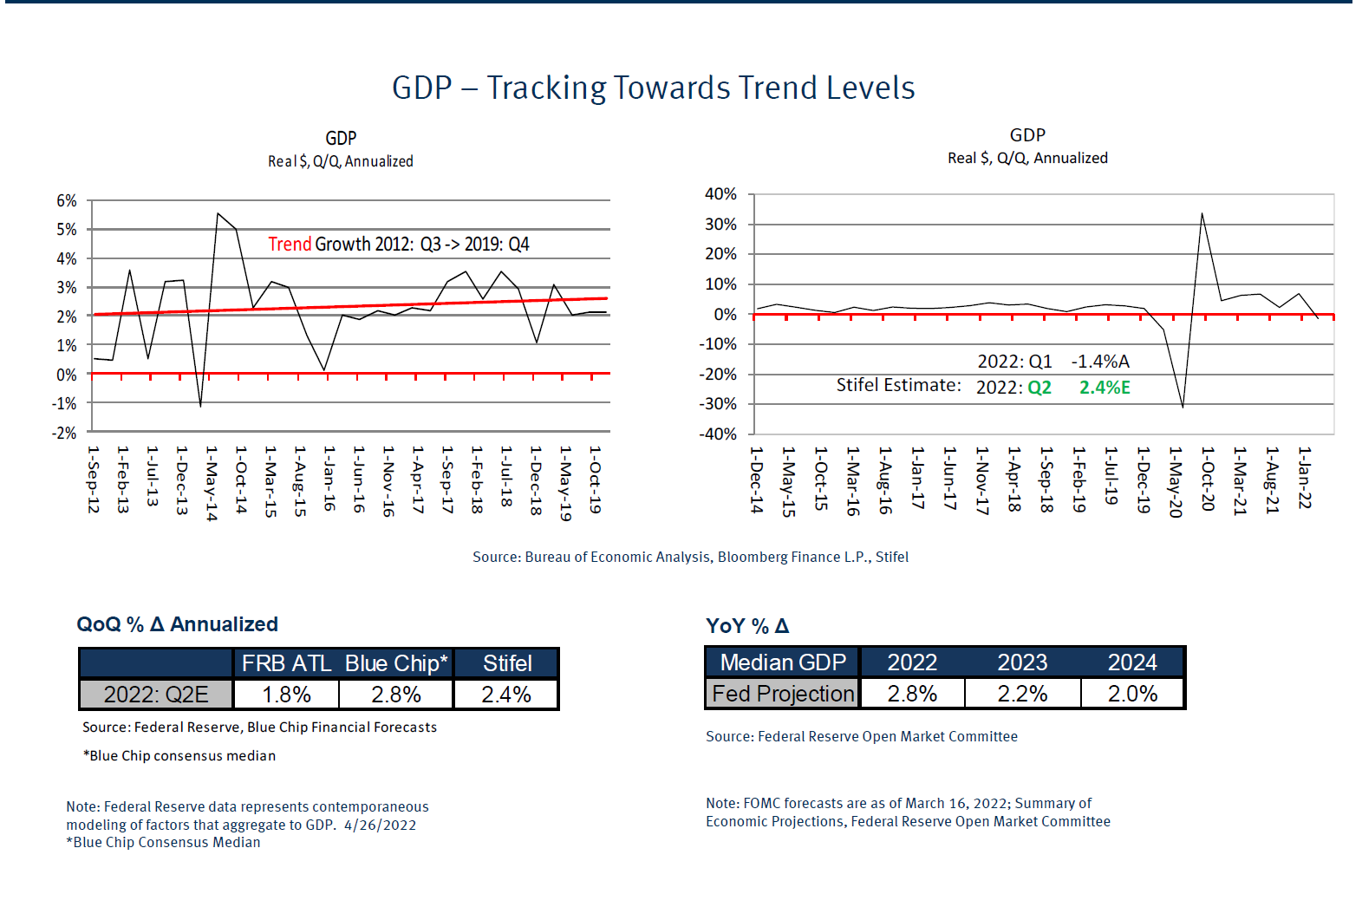

Slide 4
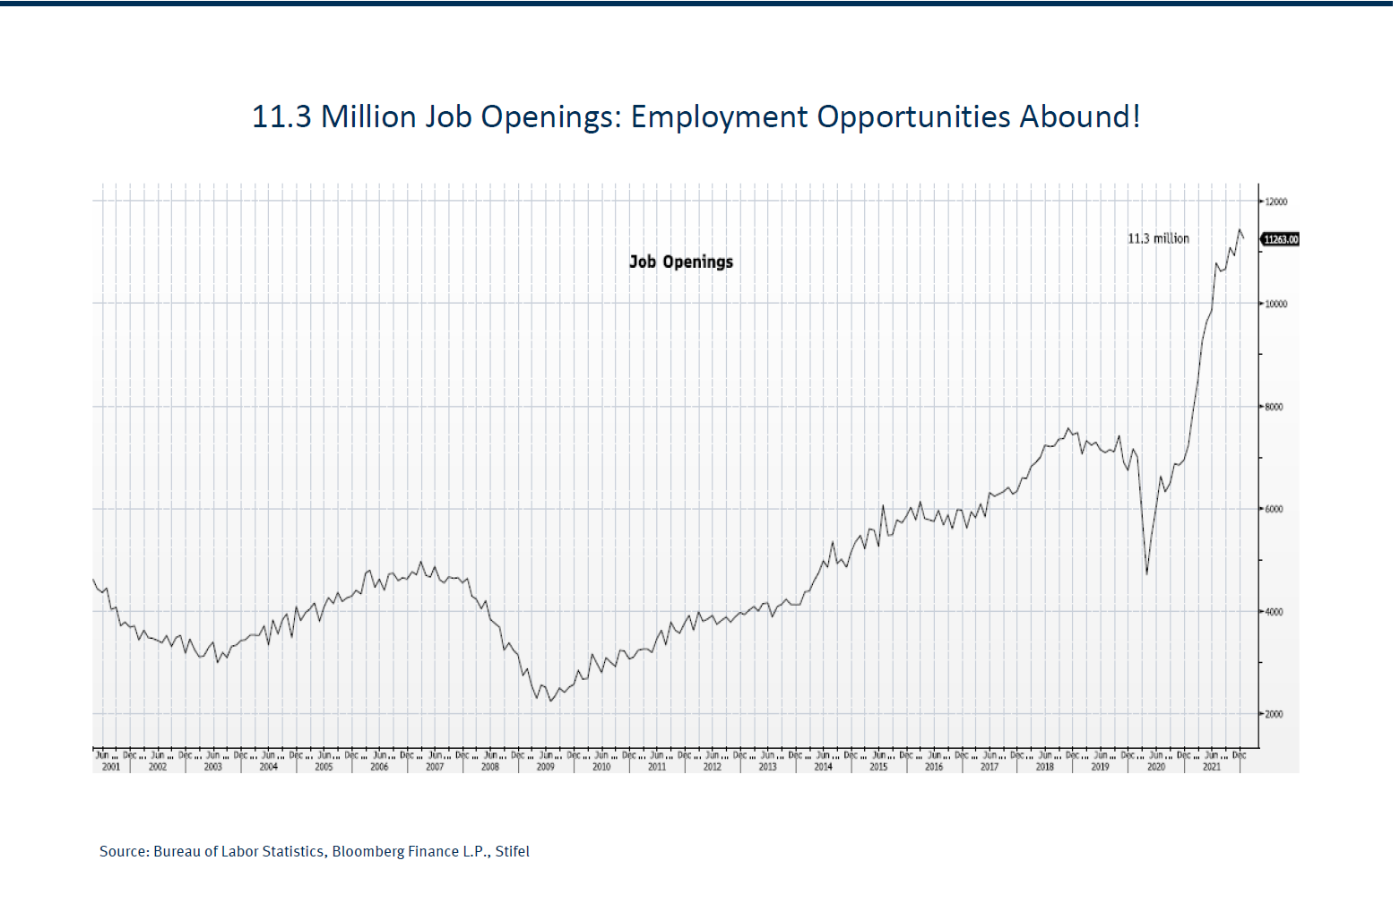

Slide 5
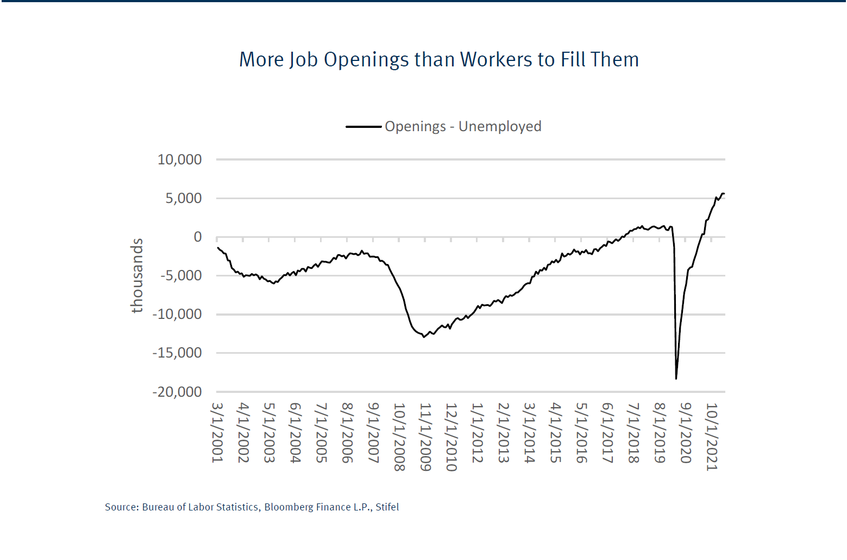

Slide 6
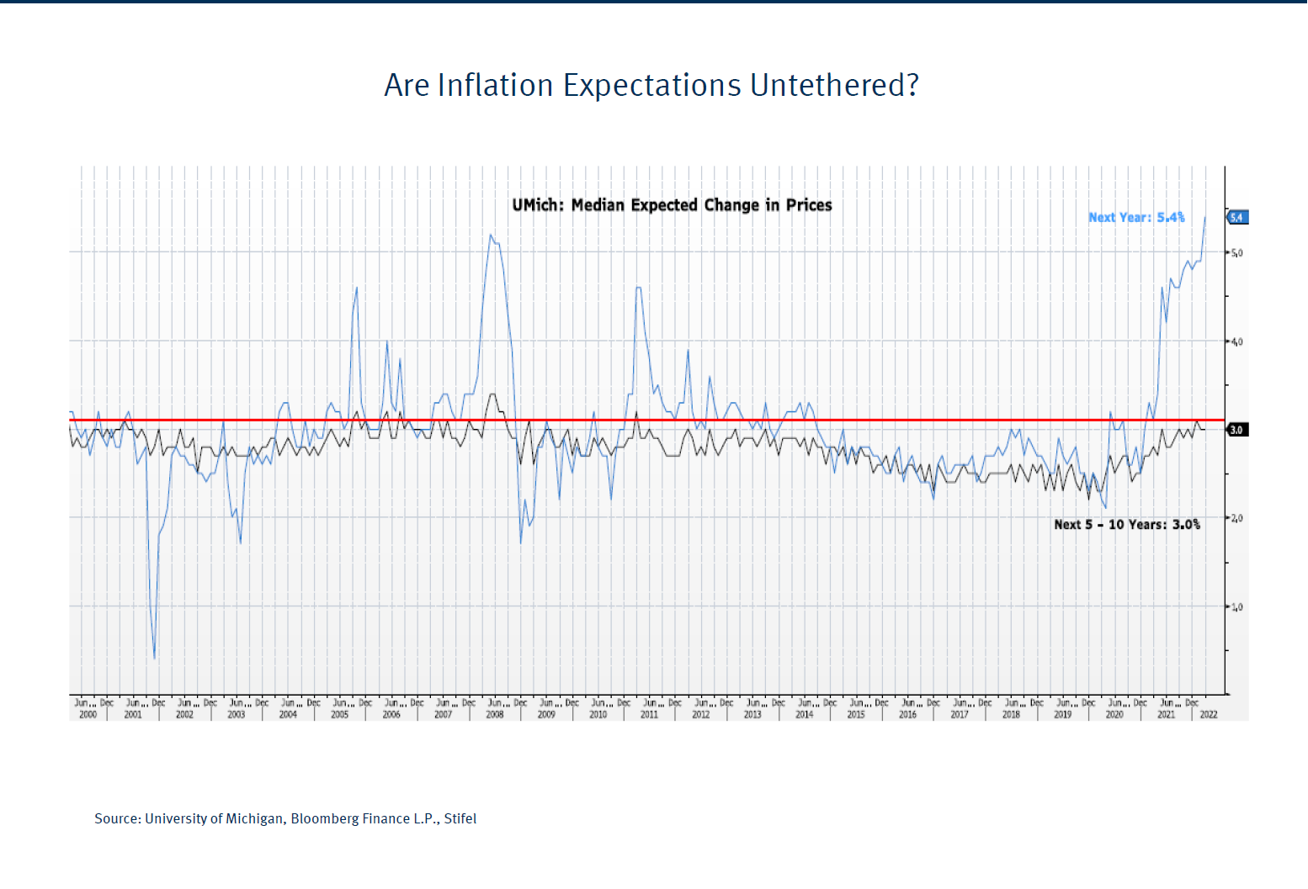

Slide 7
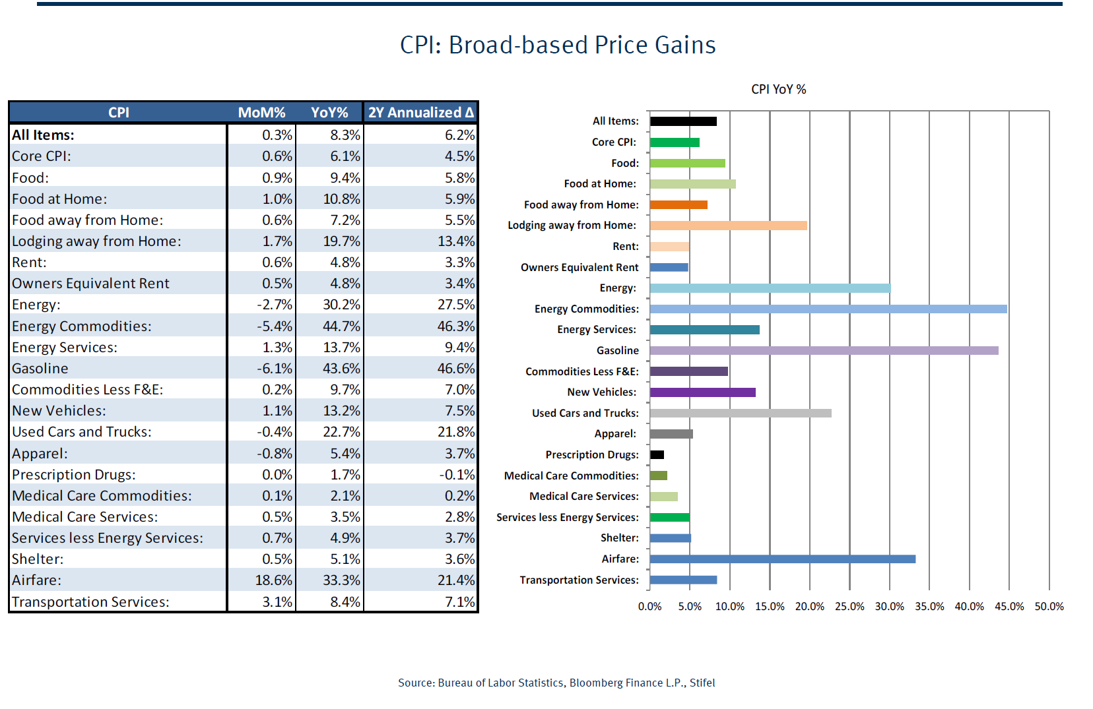

Slide 8
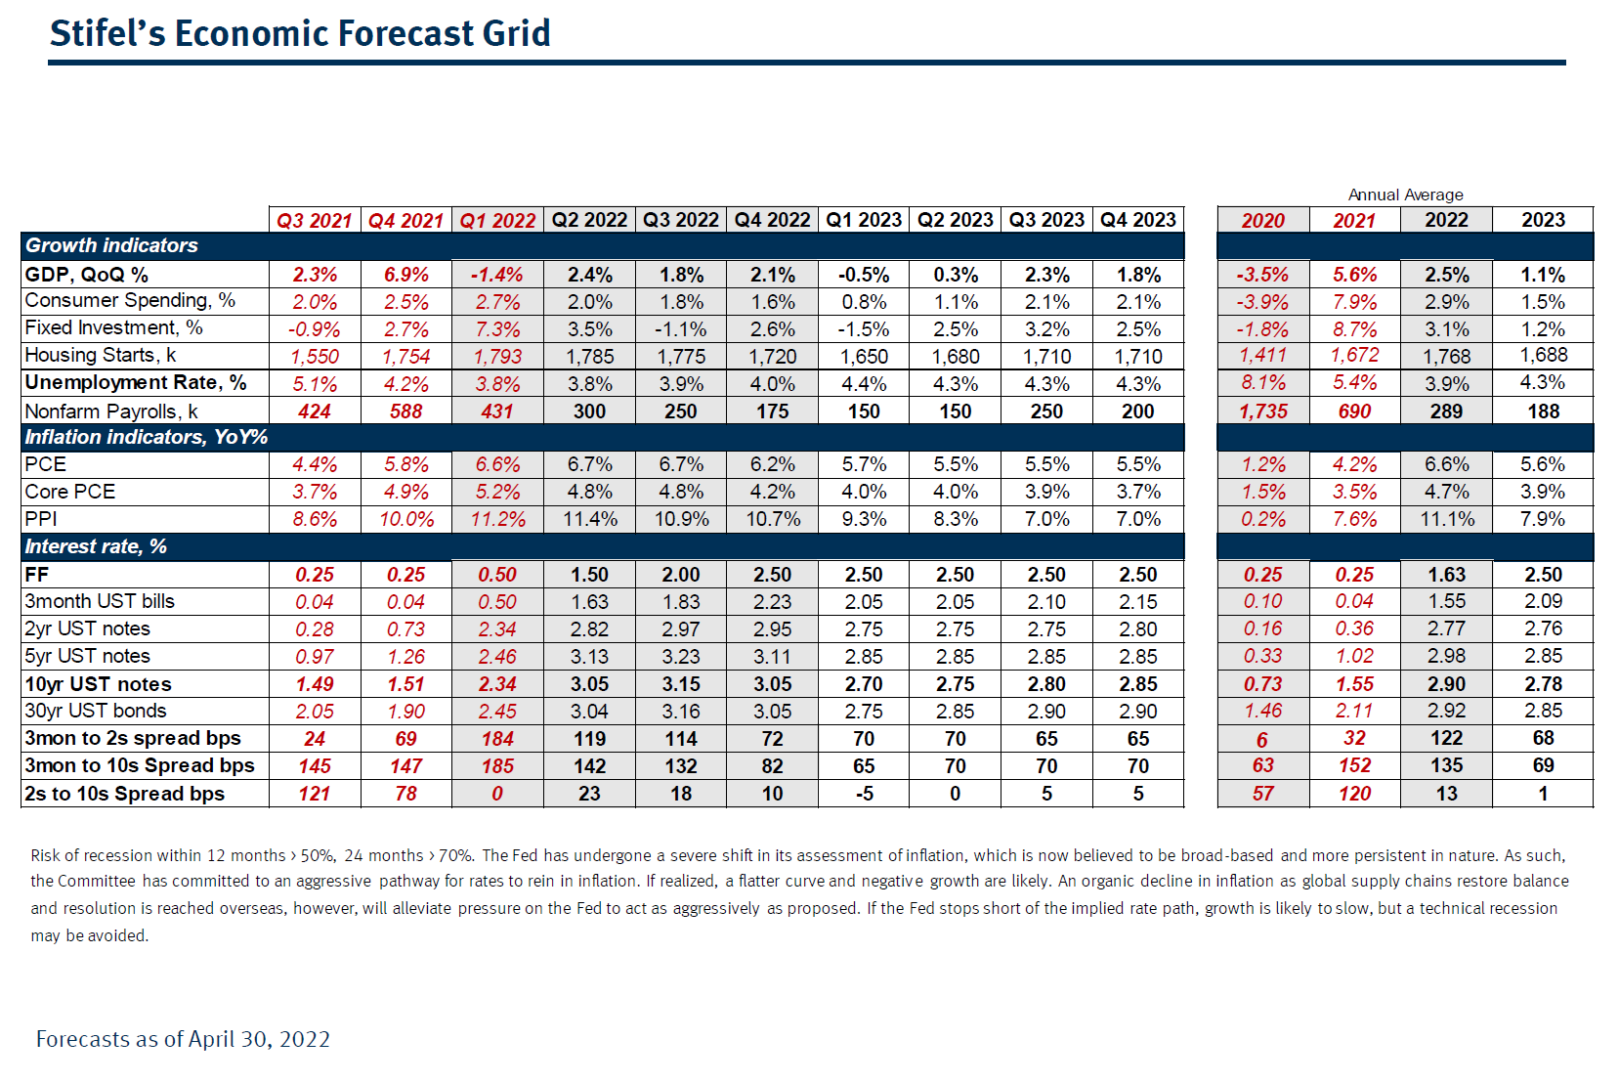

Slide 9
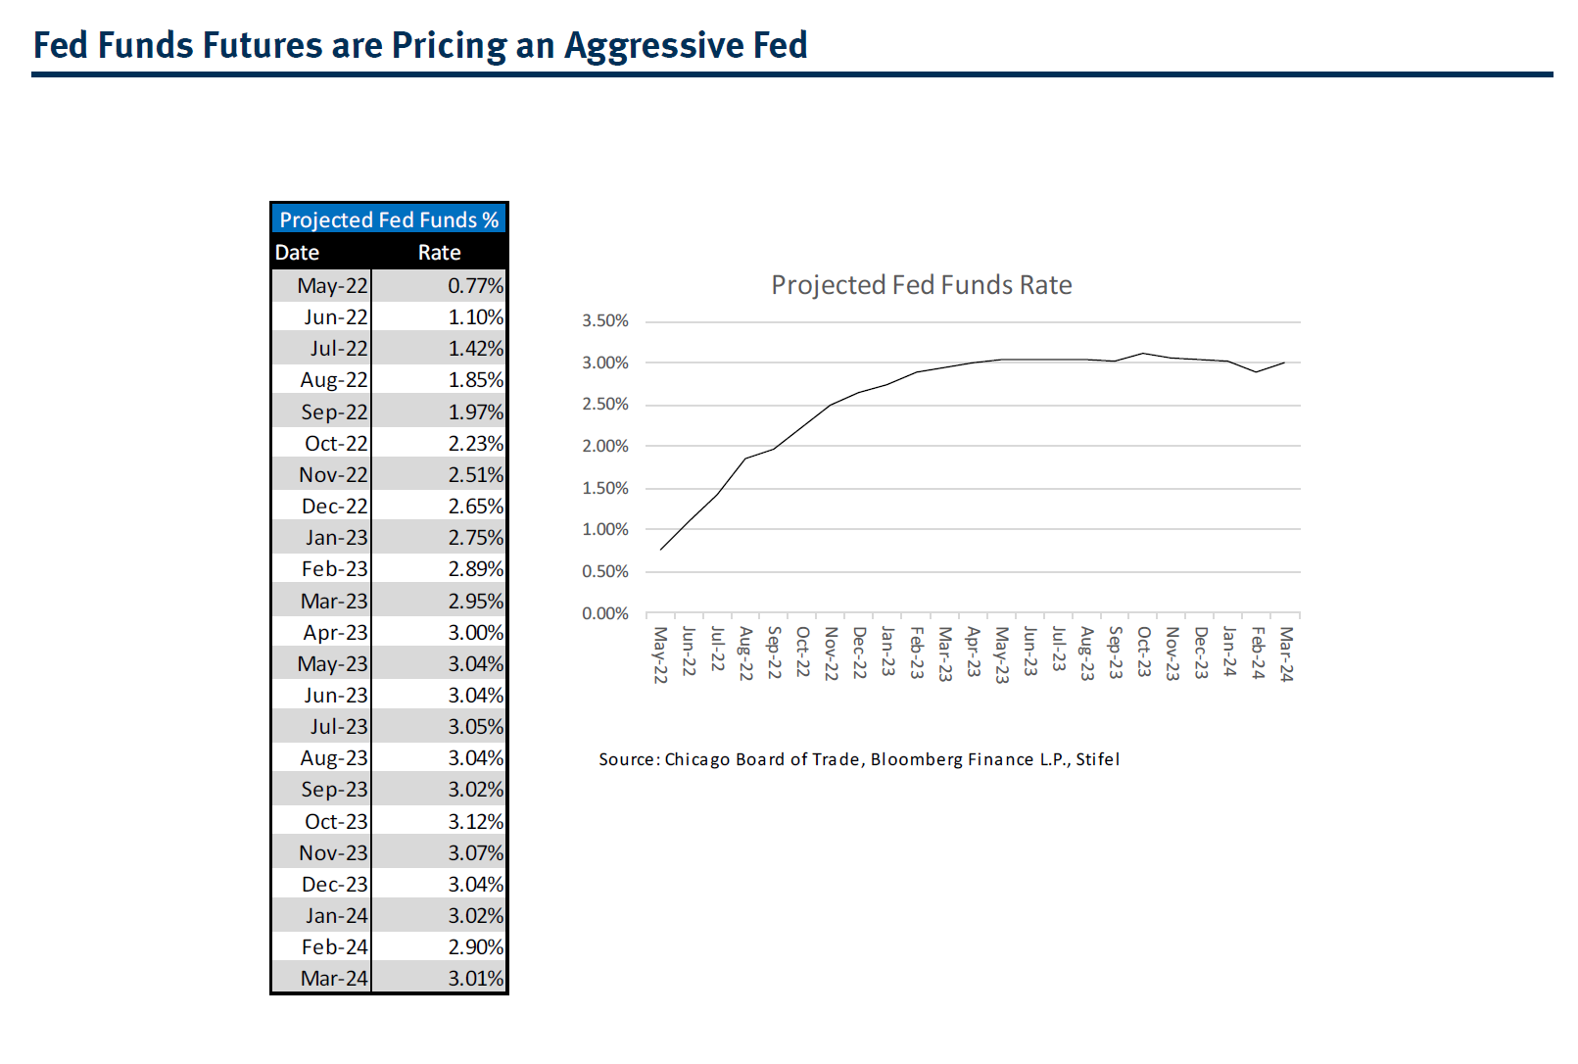

Slide 10
Laguna Beach Portfolio Update
Laura Parisi, CPA, CCMT
City Treasurer
At September 30, 2021
At April 30, 2022
$105.7 Million Dollars
Average yield 0.98%.
Benchmark 2-year T-Bill was 0.28%
Effective duration is less than stated duration and estimated at 2.46 years.
Highly rated securities.
GAAP: Unaudited unrealized loss $54,000.
$148.5 Million Dollars
Average yield 1.10%.
Benchmark 2-year T-Bill was 2.70%
Effective duration is close to stated duration and estimated at 2.8 years.
Highly rated securities.
GAAP: Unaudited unrealized loss $7.3 million.

Slide 11
City of Laguna Beach
Portfolio Yield vs. Benchmark 2 Year Treasury

Slide 12
City of Laguna Beach
2022 Investment Strategy and Policy Discussion
2022 Recommended Strategies – no significant changes recommended:
  Barbell maturities to increase yield in rising rate environment.
  Continue daily cash flow forecasting and analysis. Meet with the City Manager and Director of Investments to develop a procedure that will improve cash flow forecasting.
  In a rising rate environment, invest outside of LAIF on the short end.
  Continue buy and hold strategy and achieve a market rate of return.
  NEW - Develop a strategy with Glenn Grey on the ESG and socially responsible investing policies and procedures that will be discussed during the fourth quarter.
  NEW - Consider automation of Investments and related accounting will be performed by the City Manager. There will be an increase in the investment workload for the City Treasurer with decreases in finance and audit preparation. There should be a net savings.

